Slide 1

ANALYTICS COVID
Sergio Veliz Diana Once Melanie Guevara Frank Vera Jhonston Benjumea

Slide 2

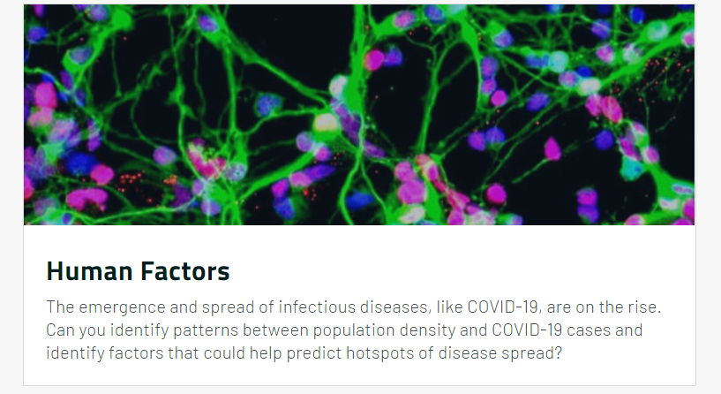
THE CHALLENGE

Slide 3
THE PROBLEM
UNEMPLOYMENT
Increased From 55% to 62%
More than 80 Millions of Students in Latin America and Caribbean Lost their Schools, and their Nourishment.
EDUCATION
Many Countries invest less than 7% on Health.
PUBLIC HEALTH SERVICES
In this year, at least 10 Millions will be pushed to Poverty.
POVERTY

Slide 4




OUR SOLUTION
USE DATA
FROM SPACE AGENCIES
Transform Data
Escalate for Graphics
Train Machine Learning Model
Implement Data from whole Latin America and Caribbean to the model
Show Graphics in App Web

Slide 5



OUR IMPACT
Minimize the impact of the pandemic,
by acting in a timely manner
The leaders can take better decisions based on data
Optimize the use of resources

Slide 6



SOLUTION BENEFICIARIES
Citizens
Politicians
Health services

Slide 7

FUTURE OF THE PROJECT
01
02
03
IMPLEMENT
TRAIN MODEL
EXPAND
Develop the algorithm in Latin America and Caribbean using the Datasets from the Space Agencies.
Using the DATA we can train the model for more precise prediction.
Improve the Dataset for more Regions in our Planet.

Slide 8


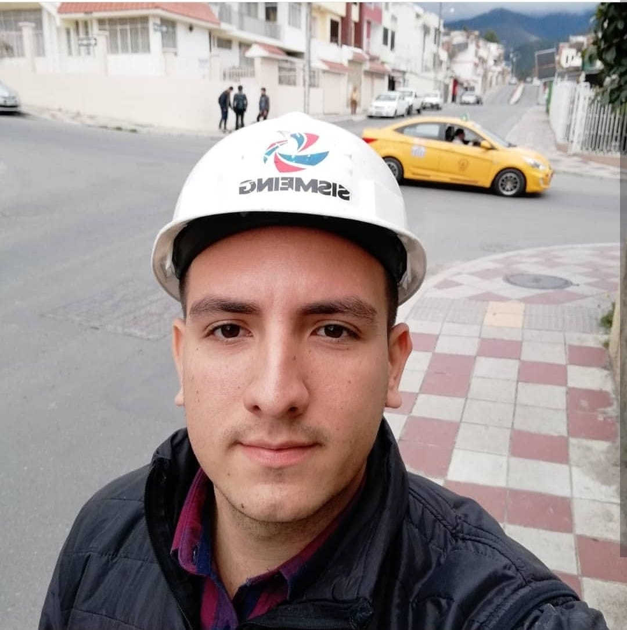



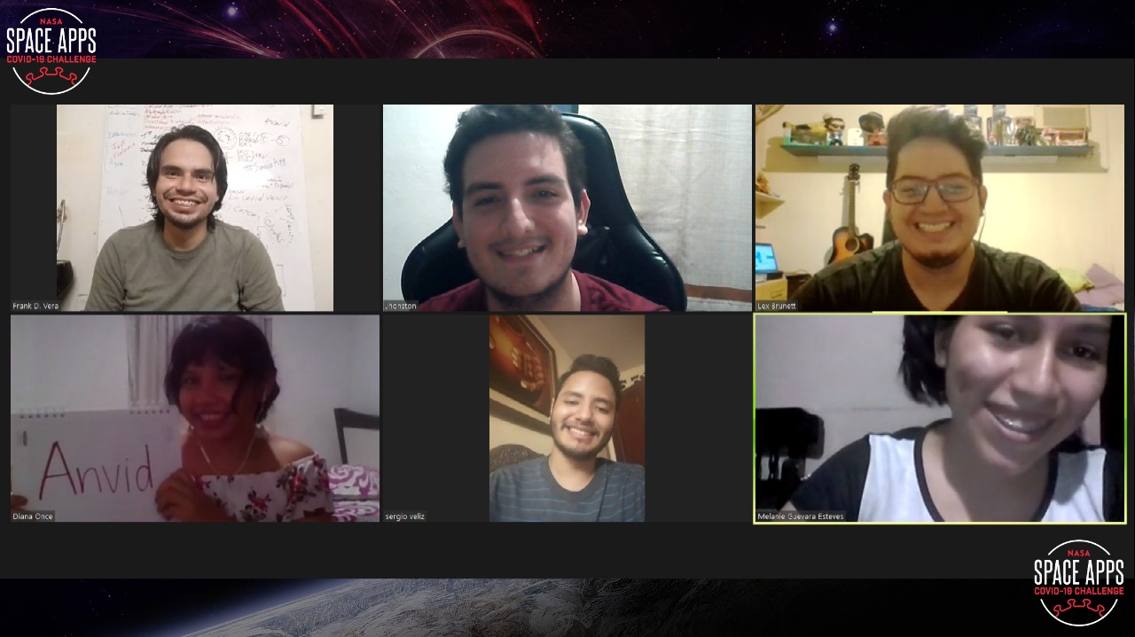
CREW MEMBERS

Slide 9
ANALYTICS COVID
ATTACKING PANDEMICS WITH DATA

